Slide 1
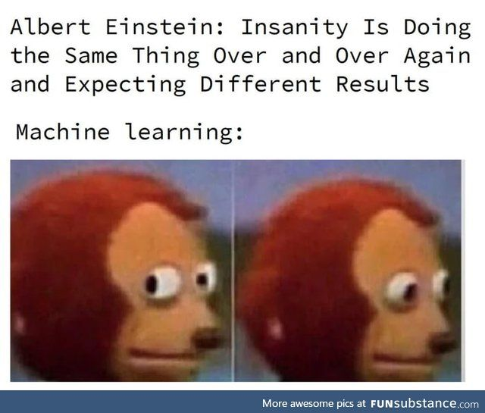
Feature Selection for Recommender Systems
(Explicit Feedback)
Bharathikannan N
Cam Van Tran Thi
Fadi Ghanem
Chee Sue Sien

Slide 2

CONTENT
Summary
Final results
Future research

Slide 3
Summary
1

Slide 4
Summary of Mid Term results
Features obtained from the dataset
Recommender System algorithm used:
Factorization Machines
Result of the algorithm with all features:
RMSE = 0.8928
{
"movie_id": 1681,
"user_id": 943,
"timestamp": 214,
"release_date": 240,
"genre": 19,
"sex": 1,
"zip_code": 19,
"age": 8,
"occupation": 21
}

Slide 5
Summary of Mid Term results
Features obtained from the dataset
{
"movie_id": 1681,
"user_id": 943,
"timestamp": 214,
"release_date": 240,
"genre": 19,
"sex": 1,
"zip_code": 19,
"age": 8,
"occupation": 21
}
Total features: 522!
Run feature selection method for different values of k,
where k is the number of selected features,
and k is an element of [0, 50, 100, … 500, 522]

Slide 6
Feature Selection Methods
Filter methods
_________________
Give each feature a score through a ranking criterion, then use a threshold for the selection.
_________________
Chi square
F-Regression
F-Classification
R-Regression
Variance Threshold
Mutual Information
Wrapper methods
_________________
Chooses a different subset of features at a time and relies on the performance of the learning model in selecting the best one.
_________________
Forward Elimination
Backward Elimination
Recursive Feature Elimination
Permutation Importance
Embedded methods
_________________
Feature selection process is an integral part of the classification/regression model.
_________________
Random Forest
Extra Tree Classifier
Logistic Regression (Select from Model)

Slide 7
Libraries used
Filter methods:
sklearn.feature_selection
Wrapper methods:
sklearn.inspection.permutation_importance
sklearn.feature_selection.RFE
sklearn.feature_selection.SequentialFeatureSelector
Embedded methods:
sklearn.ensemble.RandomForestClassifier
sklearn.ensemble.ExtraTreesClassifier
sklearn.linear_model.LogisticRegression
sklearn.feature_selection.SelectFromModel

Slide 8
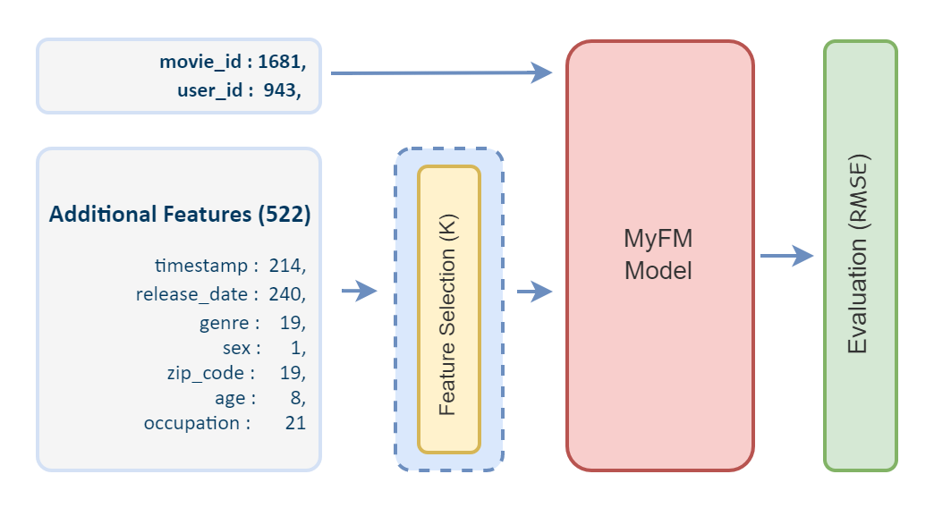
Pipeline

Slide 9
Final Results
2

Slide 10
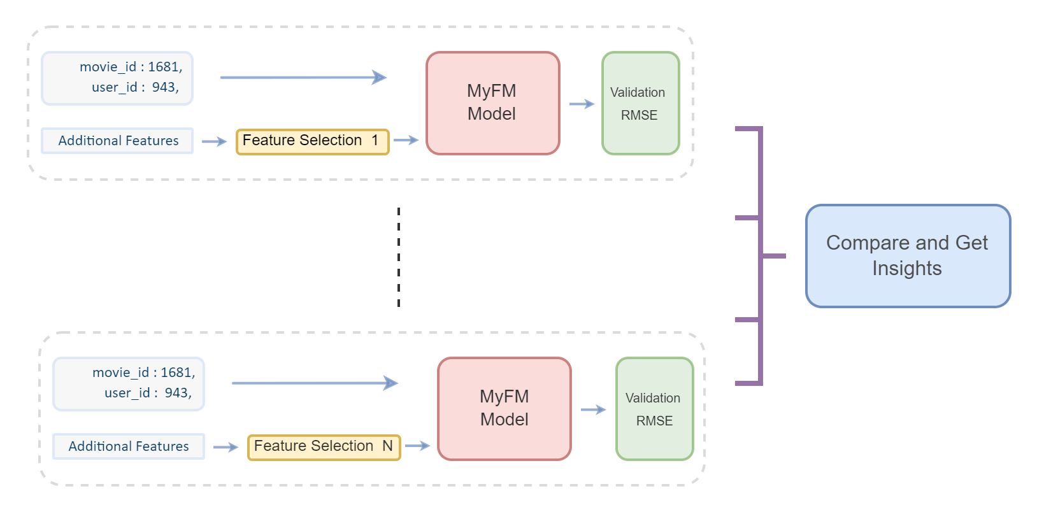
Our Goal

Slide 11
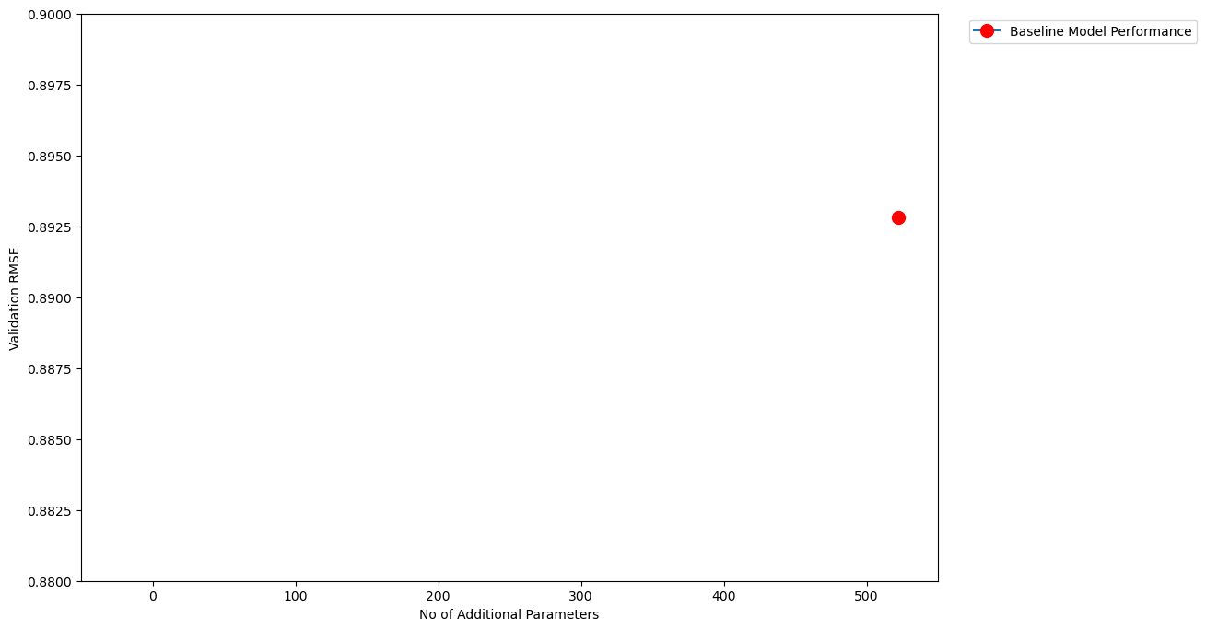
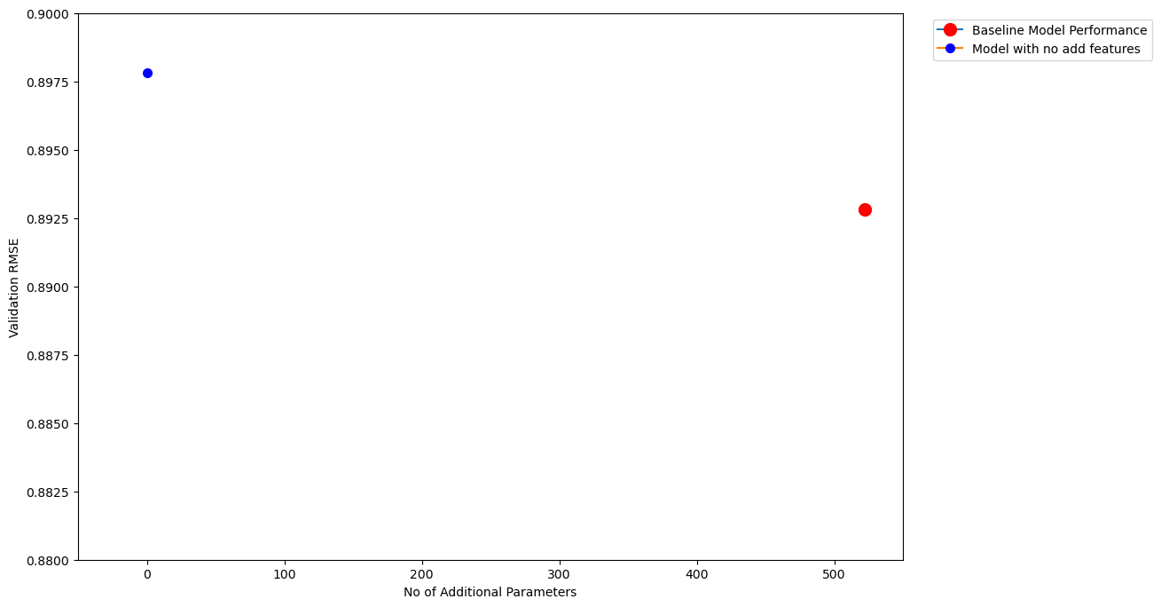
Baseline Model
RMSE:0.8978
Model
with only user_id, movie_id
Baseline Model
Performance
RMSE:0.8928
522
522
522

Slide 12
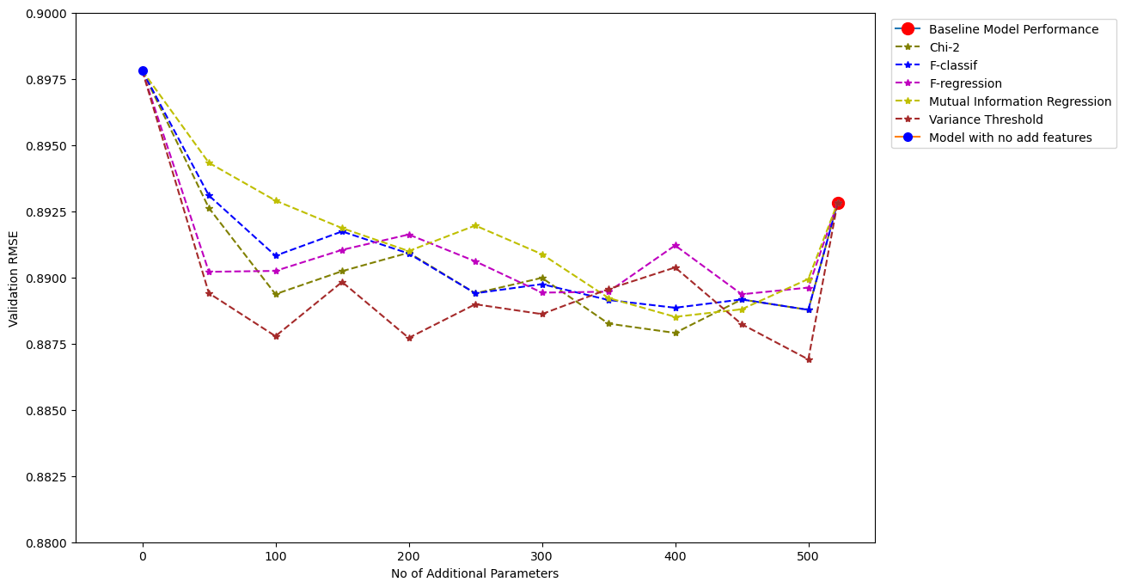
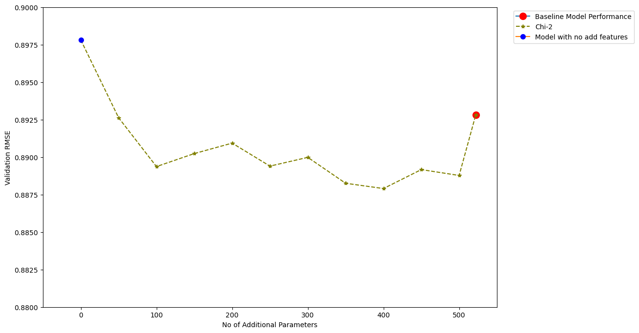
Filter Method (Chi-2)
Baseline Model
with only user_id, movie_id
Baseline Model
Performance
Top 50
Top 100
Top 150
Top 200
Top 250
Top 300
Top 350
Top 500
Top 450
Top 400
522

Slide 13
Filter Methods
522

Slide 14
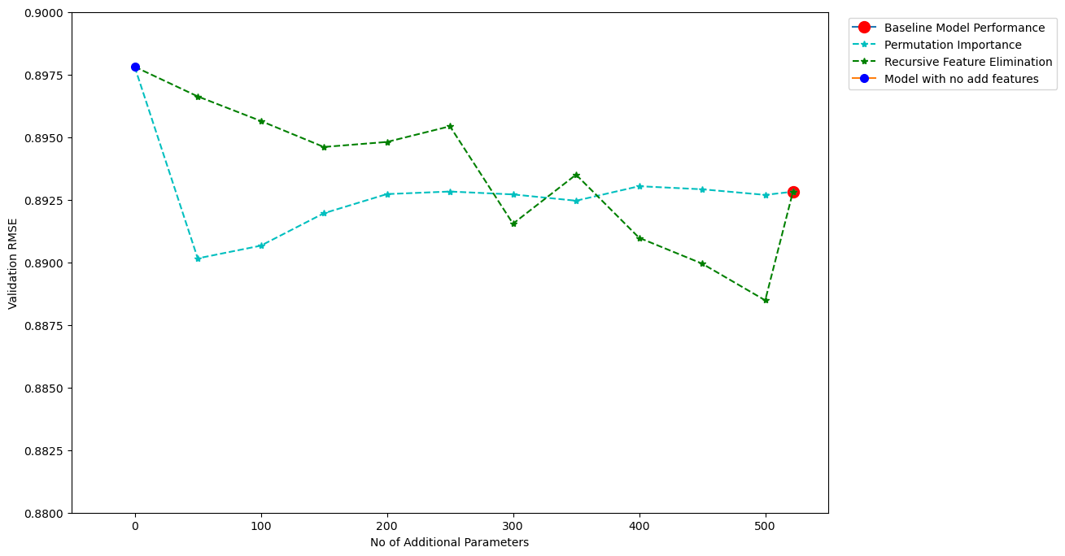
Wrapper Methods
522

Slide 15
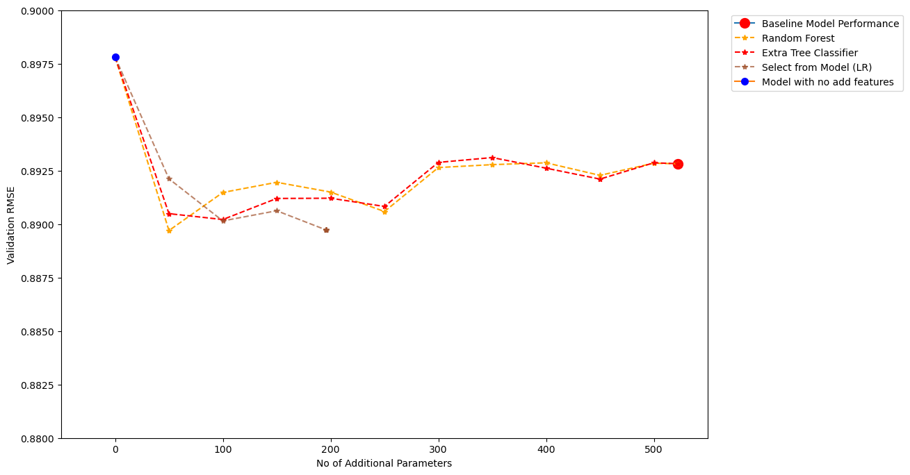
Embedded Methods
522

Slide 16
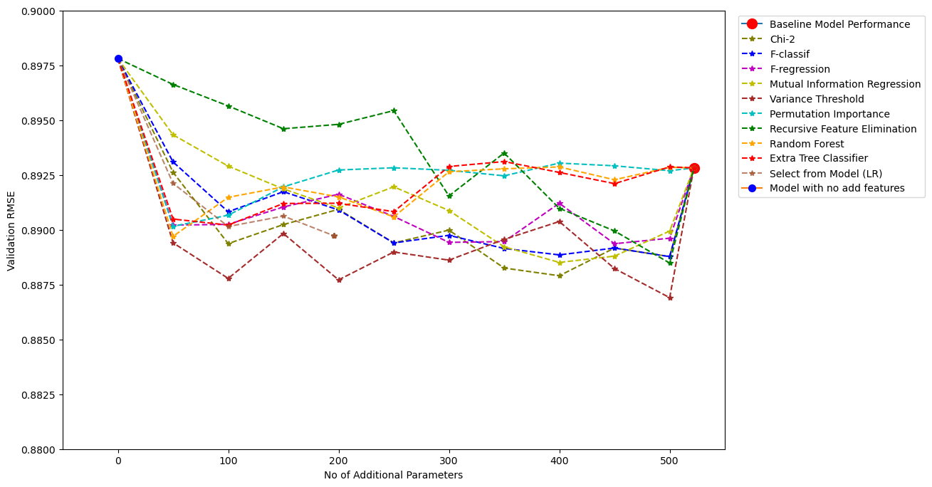
Final Results
522

Slide 17
Final Results

Slide 18
Future Research
3

Slide 19
Outlook and Future Research
Feature selection methods help to reduce dimensionality, but don’t lead to the loss of recommendation quality.
Larger datasets - takes a lot of time to train - FS methods will be very useful here
Try different baseline models (e.g. DeepFM, Wide and Deep..,)
Try different evaluation metrics

Slide 20
Thank you!
Bharathikannan Nithyanantham
Cam Van Tran Thi
Fadi Ghanem
Chee Sue Sien

